Slide 1
Focusing on Christ
Directing Thanks to the Right Person

Slide 2
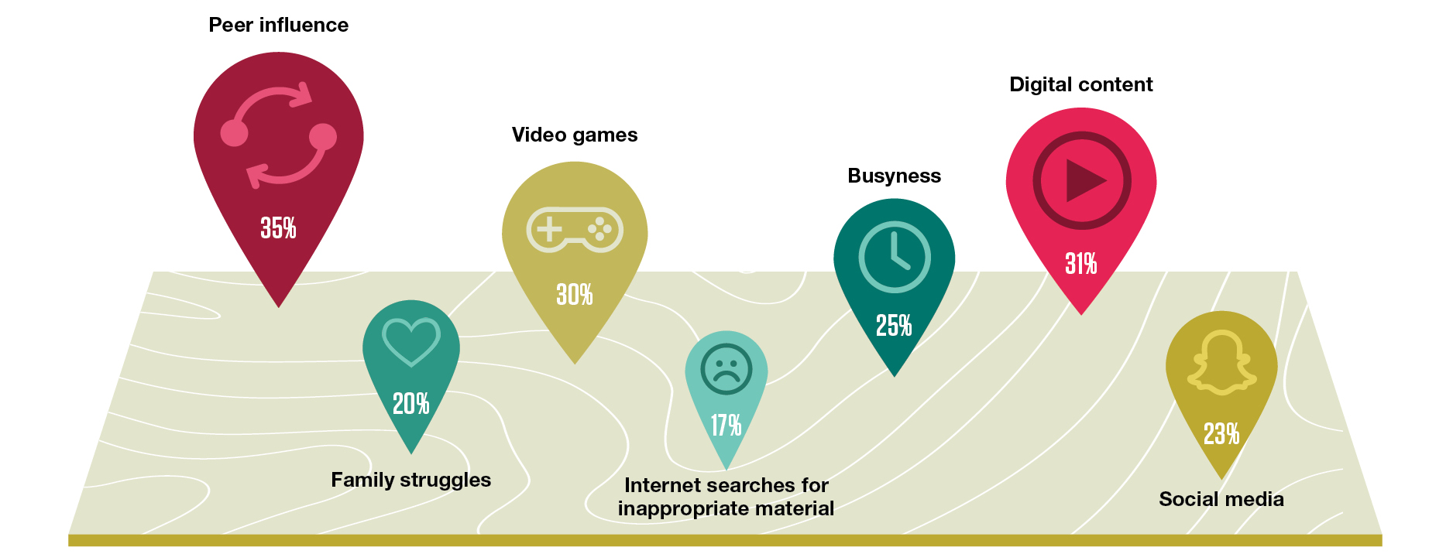
Top Parenting Struggles for Faith

Slide 3
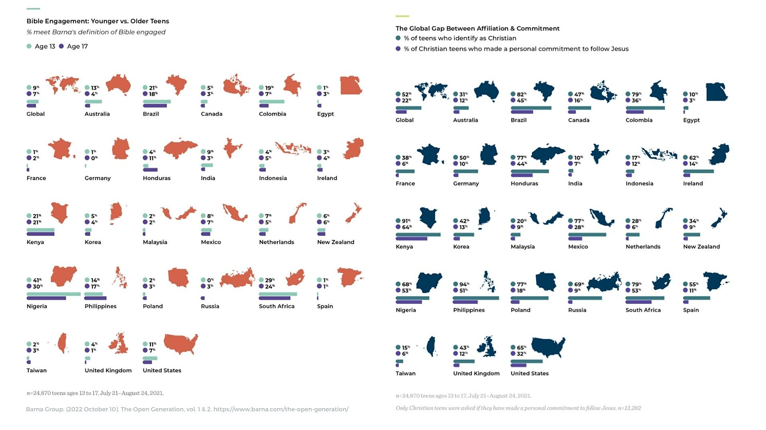
Bible Engagement in Younger vs. Older Teens

Slide 4
Global Gap Between Affiliation & Commitment

Slide 5
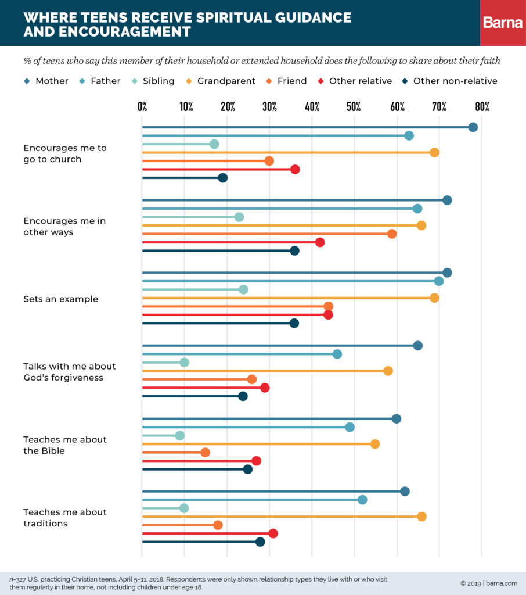
Where Teens Receive Spiritual Guidance

Slide 6
For the husband is the head of the wife even as Christ is the head of the church, his body, and is himself its Savior.
- Ephesians 5:23

Slide 7
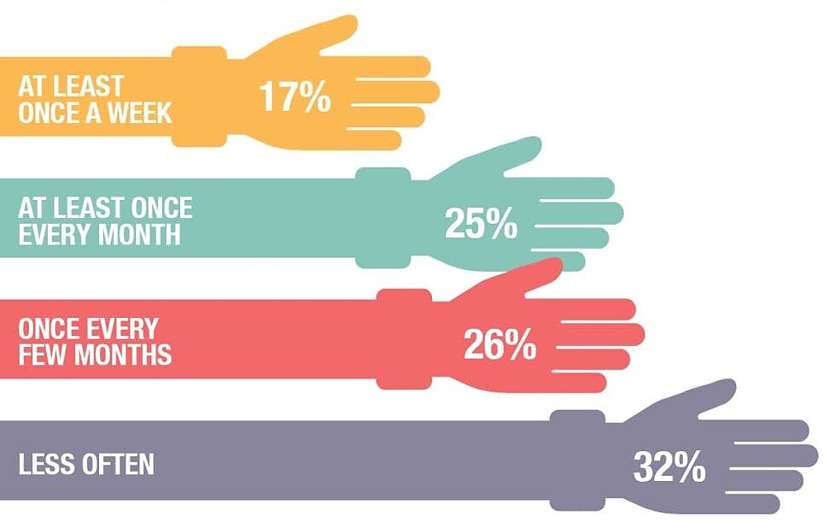
Teens Are Active Volunteers in the Church

Slide 8
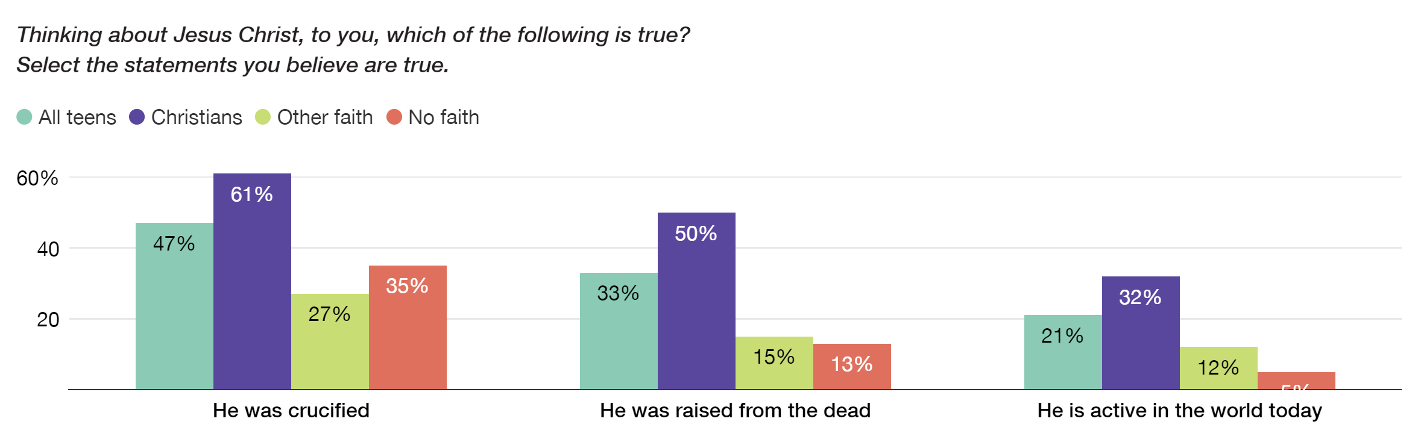
Teens’ Perspective of Jesus Christ

Slide 9
I am the true vine, and my Father is the gardener. He cuts off every branch in me that bears no fruit, while every branch that does bear fruit he prunes so that it will be even more fruitful. You are already clean because of the word I have spoken to you. Remain in me, as I also remain in you. No branch can bear fruit by itself; it must remain in the vine. Neither can you bear fruit unless you remain in me.
-John 15:1-4

Slide 10
Top 6 Reasons Young Adults Leave the Church
Churches seem overprotective.
Teens’ and twentysomethings’ experience of Christianity is shallow.
Churches come across as antagonistic to science.
Young Christians’ church experiences related to sexuality are often simplistic, judgmental.
They wrestle with the exclusive nature of Christianity.
The church feels unfriendly to those who doubt.

Slide 11

Manatee Family

