Slide 1
Homesickness
& How to Help

Slide 2
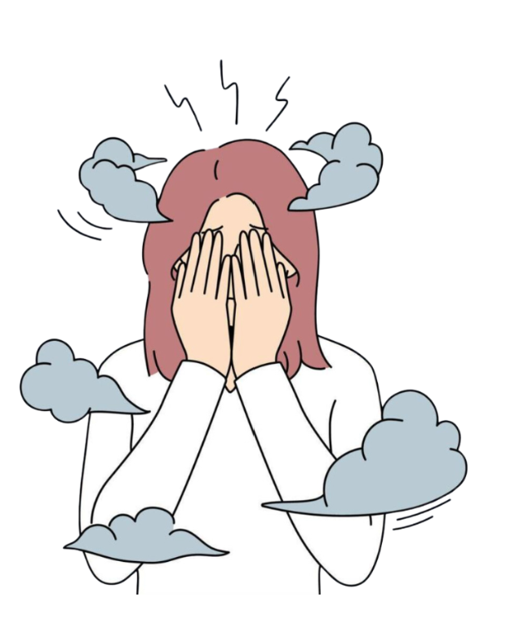
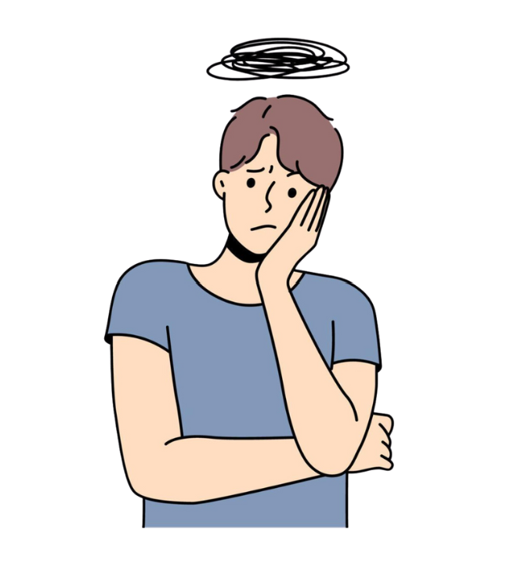
Signs of Homesickness
Depressed mood
Anxiety
Irritability
Anger
Isolation from others
Difficulty concentrating
Low motivation

Slide 3
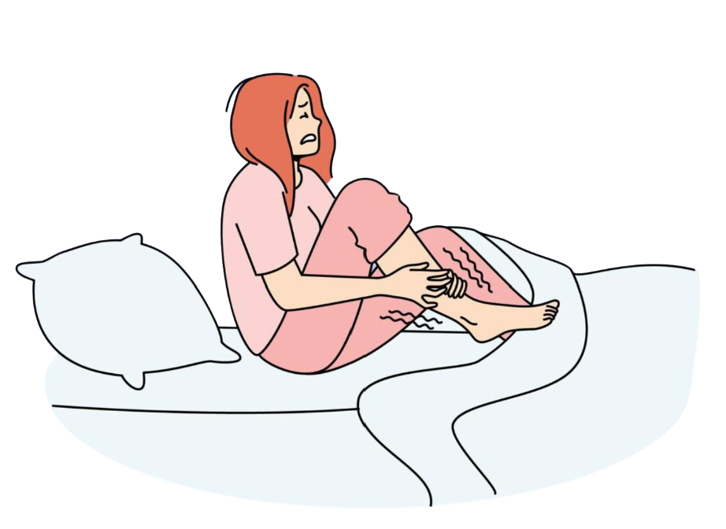
Homesickness Might be Displayed as
Difficulty sleeping or sleeping too much
Headaches
Body aches and pain
Increased or decreased appetite
Stomach problems
Low energy

Slide 4
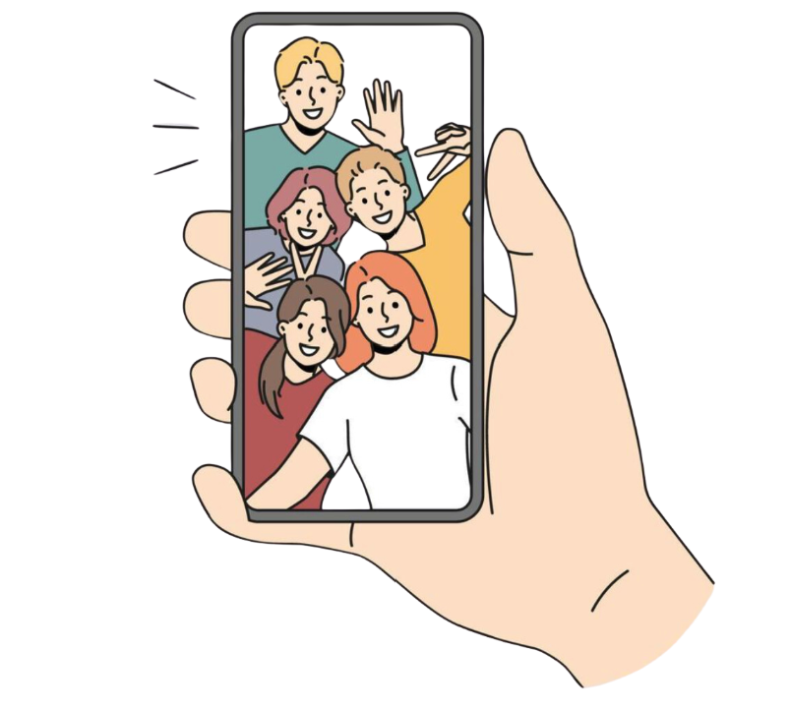
Dealing with Homesickness
Know that your feelings are normal
Find a positive outlet for your feelings
Explore your area
Keep an item that reminds you of home
Establish new memories
Take care of your health
Find ways to stay connected

Slide 5
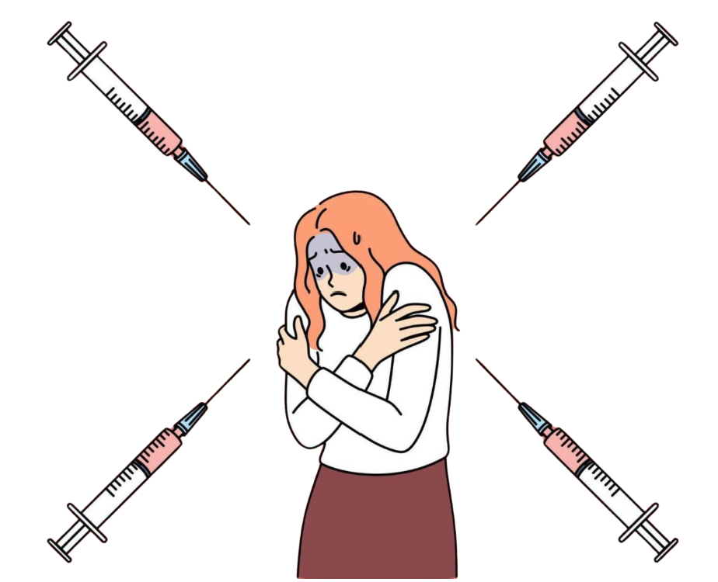
How NOT to Deal with Homesickness
Rely on bad habits
Take on too much responsibility
Make big decisions without thinking them through
Disconnect from your support system
Isolating from the outside world
Giving up on positive activities
Neglecting physical and mental health
Stopping prescription medicine

Slide 6
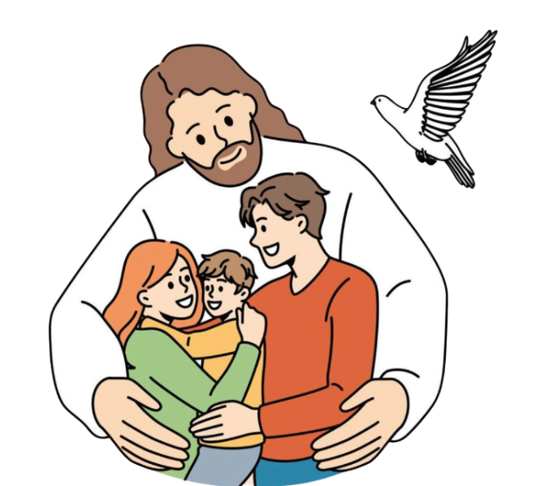
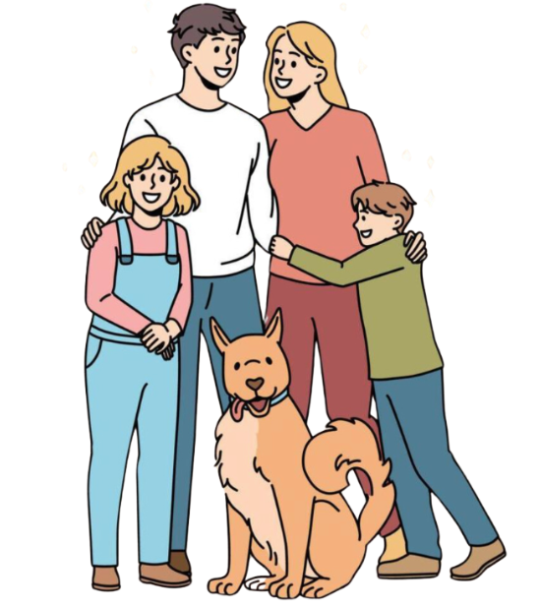
Stay in the Christmas Spirit
December often brings about homesickness
Stay strong and rejoice in Jesus’ birth
Show your international student that you care
Join the Manatee Family for a Christmas Party

Slide 7

Manatee Family
What’s Next on the Agenda?

Slide 8
Updates for the Program
Khairo
Christmas Party
Hosting?
Potluck?
Gifts?
MSOE Global Scholars (November 9th)
  10AM-2PM
  $1,000 Scholarship every year
What the Lock? (November 16th)
  11-12:30 PM
  Based on interest
2nd Semester
Critiques?
Khairo Ideas?

