Slide 1
Mental Health
& How to Help

Slide 2
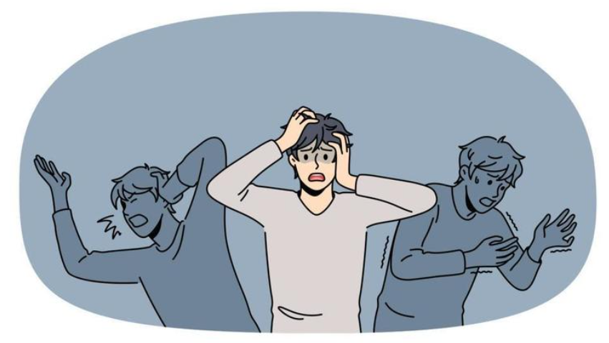
Factors Affecting Mental Health Today
Social Media
Access to Mental Health Services
Change in Environment
Lack of guidance

Slide 3
Statistics on Social Media
America
China
1 in 6 U.S children from 6-17 experience a mental illness every year
1 in 5 U.S adults experience a mental illness every year
2nd largest cause of death in the U.S is suicide
50% of lifetime cases start at the age of 14
94.9% of children in China grow up around the internet
16.4% are diagnosed with internet addiction
23.2% of middle schoolers have internet addiction
China accounts for 17% of all suicides in the world

Slide 4
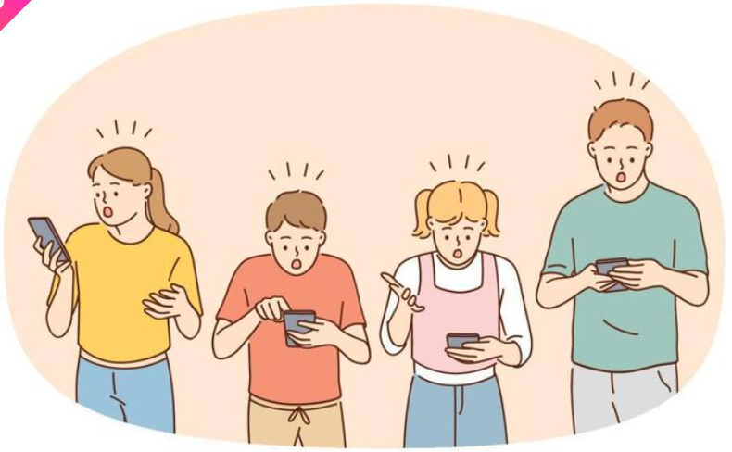
Treating Internet Addiction
Participate in as many offline activities as possible
Have an accountability partner
Establish limits on internet use
Turn off notifications
Prioritize group activities

Slide 5
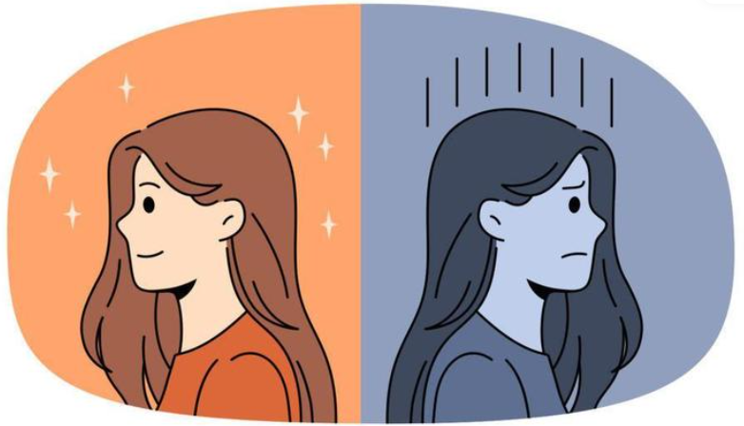
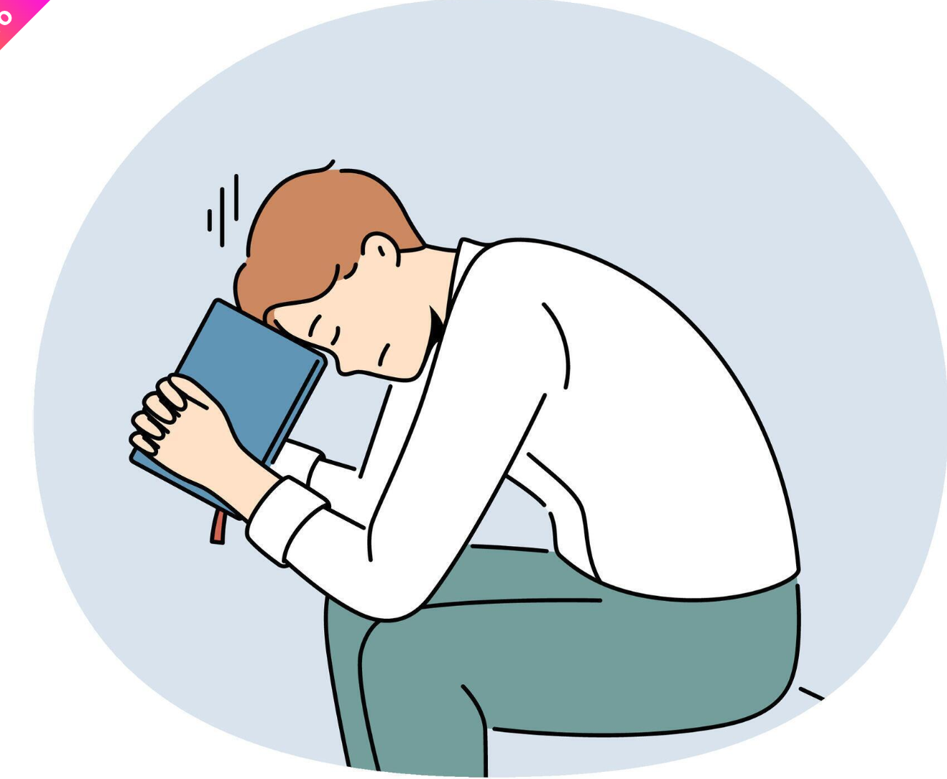
Mental Health Services at MLHS
Christian Family Solutions
  On-campus Representatives
  Support teams
  Qualified mental health professional
Campus Pastor
  Theological advice
  Connected to larger WELS community
  Religious support team

Slide 6
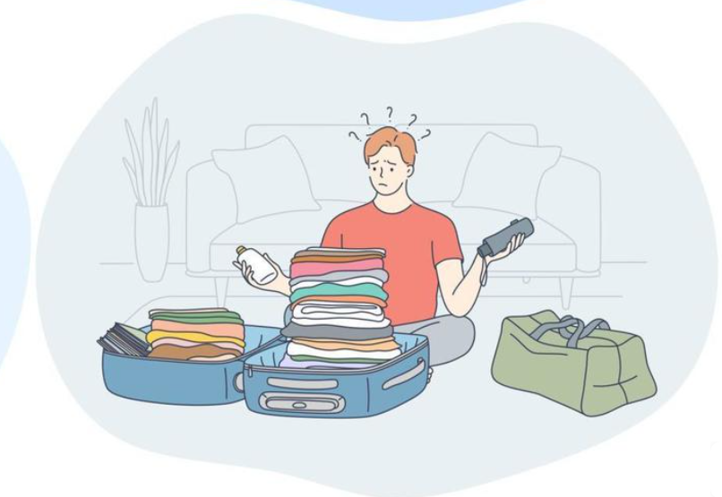
Change in Environment
What has changed?
Country
Spoken language
Family
Meal times
Chores
Bedtime
Activities
Classmates
Church
Expectations
Support group
Seasons
Beliefs

Slide 7

Change in Environment
What should change?
Expectations
Support structure
Priorities
Self-talk
Sense of adventure
Self-care
Mindset
Fears
Goals
Self-esteem

Slide 8

Lack of Guidance
Talk openly & often
Note any changes & ask for help
Pray
Step up to the plate
Look towards your community
Speak positively

Slide 9

Manatee Family
What’s Next on the Agenda?

Slide 10
Updates for the Program
Khairo
Tuition
Monthly stipend: $700
Next year’s tuition: $21,000
What is included:
  Insurance
  Basic tuition rates
  Host Family stipends
  Yearbook
  Music lessons
  Sport games (not including merch)
  Hot lunch
  Dances (not including merch)
  Khairo
  Recruitment travel
MSOE Global Scholars (November 9th)
  10AM-2PM
  $1,000 Scholarship every year
What the Lock? (November 16th)
  11-12:30 PM
  Based on interest
Christmas Host Family Meeting
Hosting?
Gifts?
Food?

