Slide 1
Dealing with Disobedience
Why are they acting up?

Slide 2
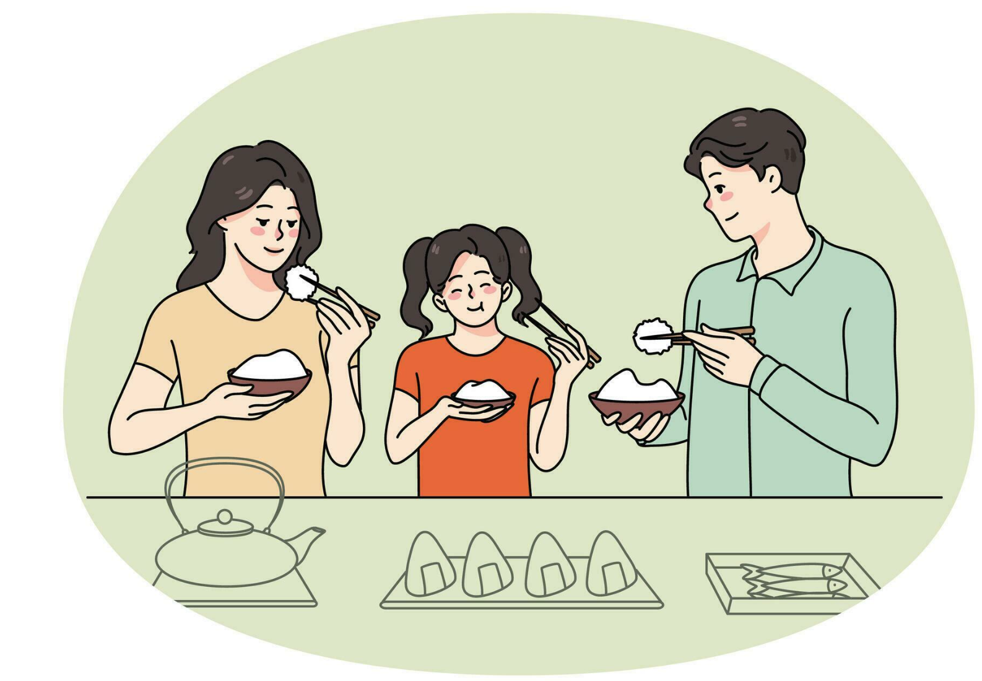
Example Family
Mr. & Mrs. Smith got along well with Susie all of 1st semester. She finished all her homework and chores; she would go to school events; she even made a close group of friends. All of a sudden, when 2nd semester came around, Susie was a nightmare! She never did her chores, got snippy at her host parents, and doesn’t hang out with her friends anymore.
What do you think is going on?

Slide 3
Susie’s Thoughts
Susie has gotten used to living in America and has started taking things for granted. She has been homesick recently and feels too down to finish her chores. Susie has also been stressed at school, so she hasn’t spent as much time around others—so that she can regain her energy.
Susie didn’t realize so much was going wrong from the perspective of her host parents, but she also doesn’t know if she can fix anything.

Slide 4
The 8 C’s of Hosting
Calm: Losing your temper will never solve the problem. Demonstrate control for them to mimic.
Clear: Keep in mind that English is not their first language, and being clear is the best way to make sure they understand the situation.
Connected: Remind your student that you care for them, and love them.
Consistent: Have repetitious consequences for their actions. Make sure they know what the consequences are
Communicative: Teens already have selective hearing, so being as communicative as possible will give the best results.
Cooperative: Understand the differences you all face. Is this something worth fighting about? Is there middle ground? Can everyone be happy?
Choiceful: Disciplining your student when they are in the wrong is a great way of showing them what the best option is.
Christ-Centered: Keep Christ in the middle of it. We are all sinful and need Him.

Slide 5
Let all bitterness and wrath and anger and clamor and slander be put away from you, along with all malice. Be kind to one another, tenderhearted, forgiving one another, as God in Christ forgave you.
- Ephesians 4:31-32

Slide 6
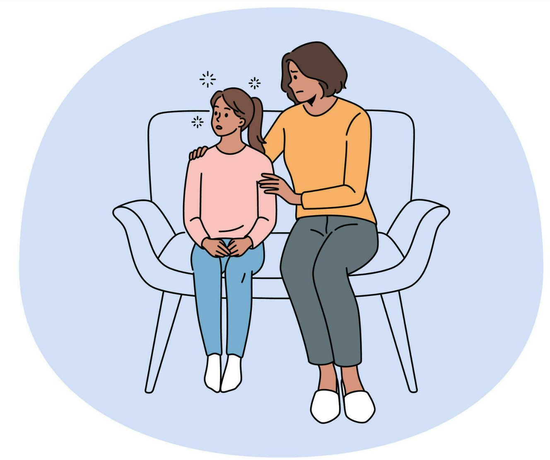
How Should We React
As Christians and mentors, we should listen to our student with empathy. More likely than not, they never realized they were in the wrong. They may even need multiple conversations to show them the true nature of their actions.
Remember, they are a kid. They think they know more than they do. Stay calm, listen openly, set clear rules, and set a good example.

Slide 7
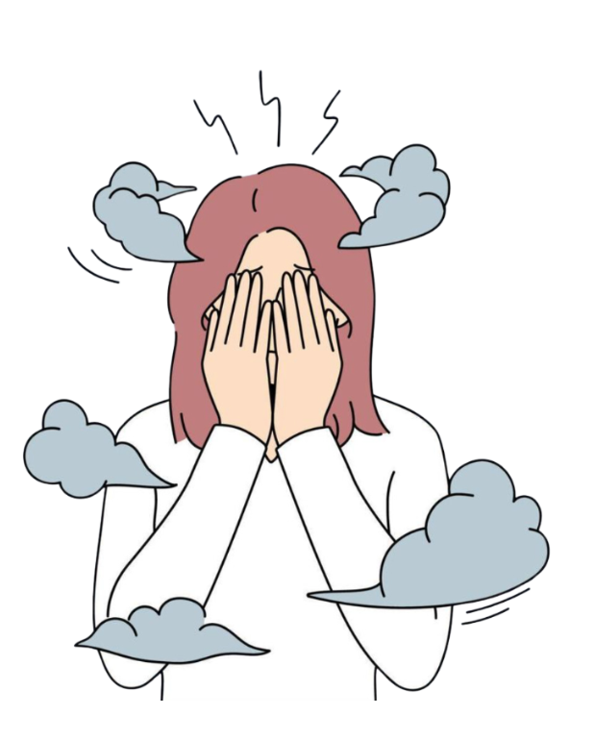
If You Need Extra Help
The International Coordinator is capable of a lot of things, but some matters are out of their control. Ask yourself if this is a personal difference with the student or a mental health problem. If it is a personal situation, the International Coordinator can intervene, but more serious matters deserve extra attention and may be followed up by counseling services.

Slide 8

Manatee Family

