Slide 1
Hygiene
& How to Deal With It

Slide 2

Standard Hygiene in China
Personal Hygiene:
Typically bathe once a day
Wash their hands before & after eating
Do not touch/like to be around “dirty items”
Take oral health seriously
Care about outward appearance

Slide 3

Why Might Our Students Smell?
ABCC11
Gene Mutation
Stops the smell of sweat
80-90% of East Asians have it
May not know how to combat sweat since most don’t have this issue

Slide 4


Why Might Our Students Smell? Contd.
Parental Outlook
Rules & responsibilities
Help with washing?
How to Combat an Attitude
Find a private space
Be direct & polite
Connect to cleanliness & dignity

Slide 5

Standard Hygiene in Spain
Personal Hygiene:
Typically bathe every other day
Wash their hands before eating
Take oral health seriously
Care about outward appearance

Slide 6

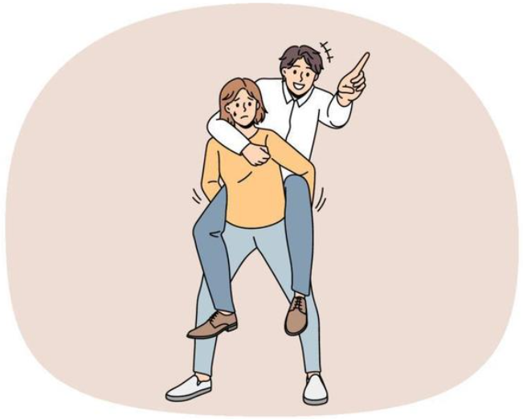
Why Might Our Students Smell?
Carboxylic Acid
Teens produce more sweat
Steroids in Teens’ Body Odor
5α-androst-16-en-3-one
5α-androst-16-en-3α-ol
Musk, urine, sweat, sandalwood
Pheromone???

Slide 7
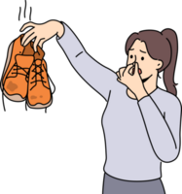
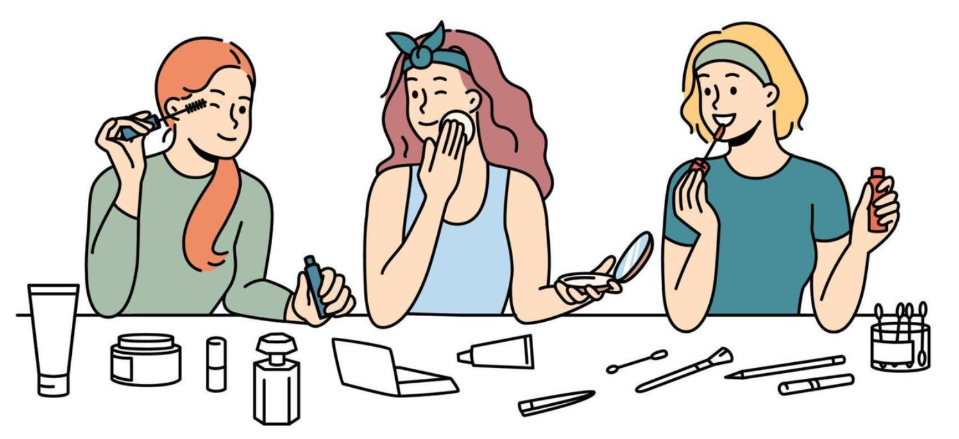
Why Might Our Students Smell? Contd.
Parental Outlook
Lack of communication around odor
New to puberty
How to Help Them
Friends are essential
Talk positively about hygiene
Shower more often
Compliment them when they smell/look better

Slide 8

ManAtee Family
What’s Next on the Agenda?

Slide 9
Host Family Meetings
Option 1
Option 2
In-person every month
Recording of the meeting
Monthly theme
Hosted by Manatee Family
Students come to the 1st meeting, the Christmas party, and the End-of-Year party
In-person twice a semester
Recording every month by Director
Themes only for recordings
Students come to the 1st meeting, the Christmas party, and the End-of-Year party (hosted by Manatee Family)
Check-in hotline in Teams

Slide 10
Updates for the Program
Curriculum
Khairo
ESL 1 & ESL 2 will be available next year
Tuition
Currently working with the Financial Director
Fixing tuition breakdown
Raised stipend?
Corn Maze (October 26th)
  2-5PM
What the Lock? (November 9th)
  11-12:30 PM
Host Family Meeting?
Option 1 or Option 2?
Hosting?

